Slide 1

PPT Topic

Slide 2
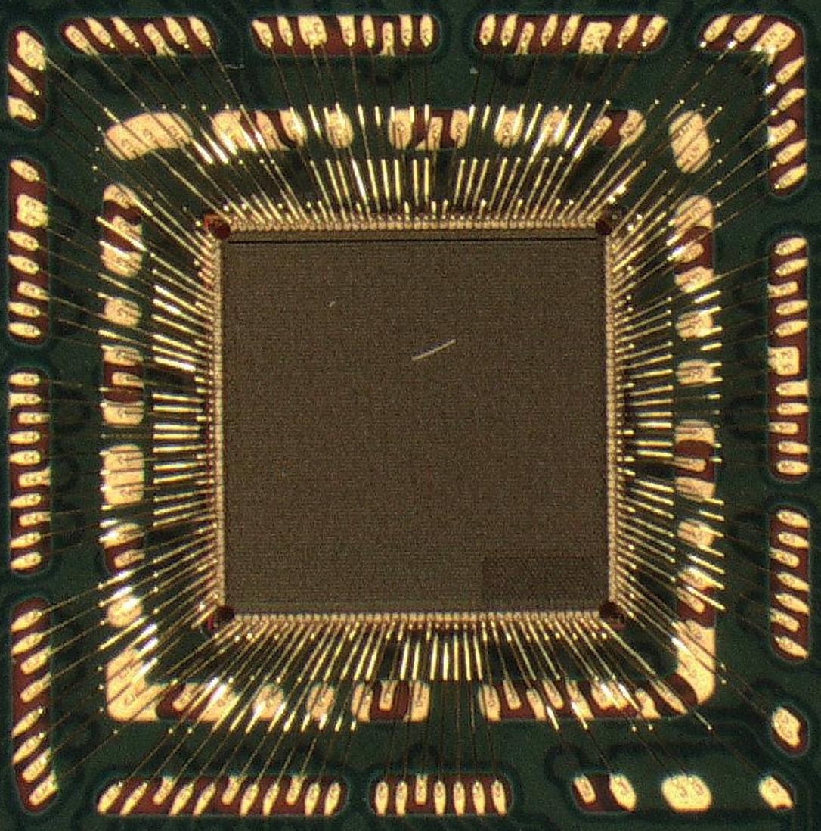
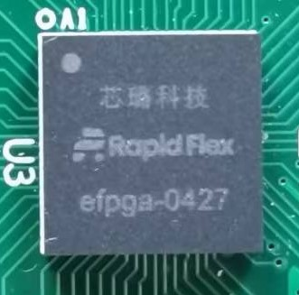
Vendor | PN | Tech node | LUTs# (K LE) |  | DFF# | DSP# |  | BRAM (Kbits-#) |  | Std. test cases - Fmax (MHz) |  |  | Video scaling - Utilization
 |  |  |  |  |  |  |  |  |  | ( LUT only) +CNT +Shift +Adder | (LUT & DSP) +Shift +Mul) | (LUT & BRAM) +Shift +RAM r/w | LUT && DSP && BRAM +CNT +Shift +Adder +MAC +RAM r/w
Xilinx | XC7S6 | 28nm | LUT6 | 6 | 7.5 | 25*18 | 10 | 18 | 10 | 384 | 151 | 384 | IO not enough
Xilinx | XC6SLX9 | 65nm | LUT6 | 9.2 | 11.4 | 18*18 | 16 | 18 | 32 | 323 | 62 | 280 | Fitted by upgrading device
Altera | EP4CE6 | 60nm | LUT4 | 6 | 6 | 18*18 | 15 | 9 | 30 | 250 | 176 | 238 | Fitted (Parts of DSP by LUT)
Lattice | XO3L4300 | 65nm | LUT4 | 4.3 | 4.3 | - | - | 9 | 10 | 271 | 81 | 165 | IO/DSP/BRAM not enough
Lattice | ECP5U-12 | 40nm | LUT4 | 12.1 | 12.1 | 18*18 | 28 | 18 | 32 | 257 | 354 | 215 | Fitted by upgrading device
Anlogic | EF3L45 | 55nm | LUT4 LUT5 | 4.5 | 4.5 | 18*18 | 15 | 9 32 | 12 6 | 292 | 92 | 305 | DSP/BRAM not enough
Gowin | GW1N- 4 | 55nm | LUT4 | 4.6 | 3.45 | 18*18 | 16 | 18 | 4 | 187 | 185 | 136 | DSP/BRAM not enough
Efinix | T4F49 | 40nm | LUT4 | 3.8 | 3.8 | 18*18 | 4 | 5 | 15 | 144 | 104 | 129 | IO/DSP/BRAM not enough
RapidFlex | RF MPW1 | 22nm | LUT4 | 4.7 | 9.4 | 28*20 (14*10) | 12 (24) | 9 | 48 | 200 | 110 | 275 | Domain specific Architecture

Slide 3
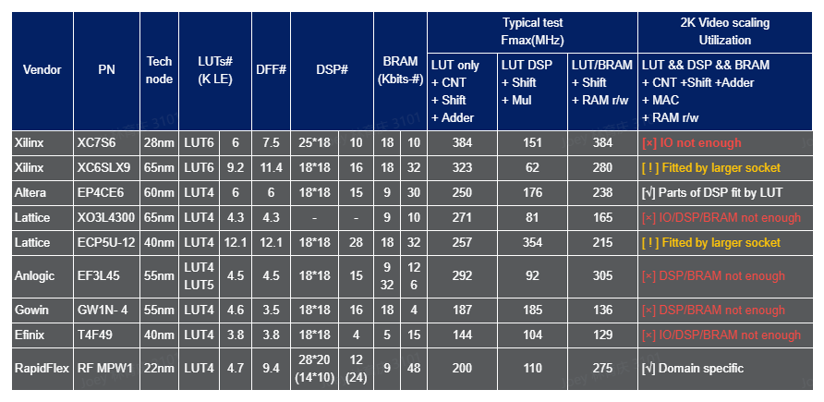

Slide 4

Thank you

